Slide 1

Exploring Smoking Prevalence in South-Holland
Mid-Bootcamp Project
by
Alireza Shahbabaie
Data Analyst Student
Friday, October 7, 2022

Slide 2

Friday, October 7, 2022

Slide 3

Research Questions
Is there any association between smoking prevalence and size of cities ?
Is there any associations between loneliness and smoking rate?
Do people feel lonelier in big cities compared to small cities?
Do people with physical limitations smoke more than others?
Is there any relationship between obesity and smoking prevalence?

Slide 4



Database From
Central Agency for Statistics
Municipal Health Service (GGD )

Slide 5
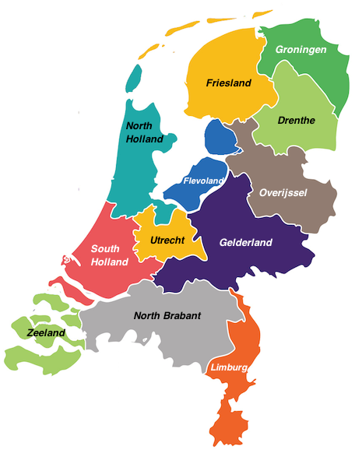

Slide 6
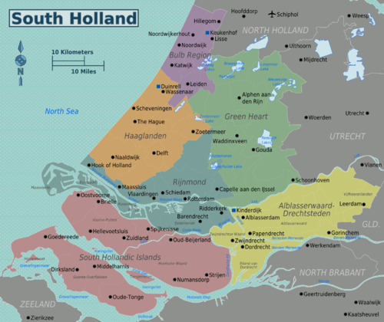

Slide 7
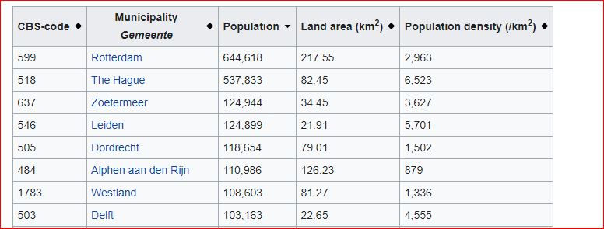
Big Cities = Population > 100000

Slide 8
Two hypotheses
Smoker percentage in big cities is grater than Smoker percentage in small cities
Loneliness percentage in big cities is grater than loneliness percentage in small cities
Notes:
t-value = -16.298340510376637 p-value 1.8798763545186394e-58 we reject null hypothesis
(-3.417985145331314, -2.68923822710945)
t-value = -26.916410277746884 p-value = 1.2420024314620105e-150 we reject null hypothesis
(-7.913898435500508, -6.836812716859802)

Slide 9
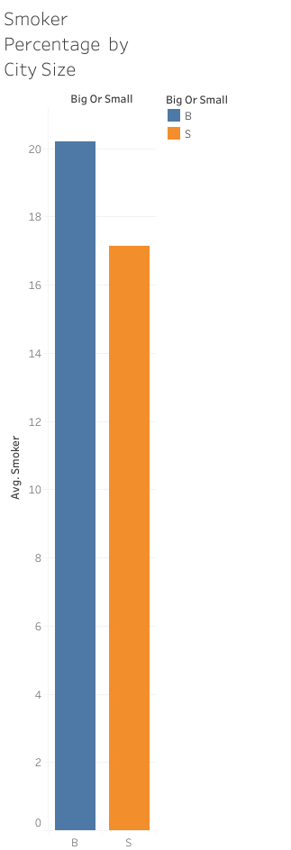
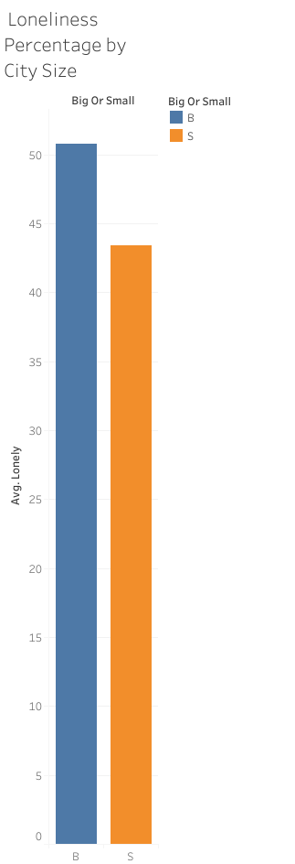
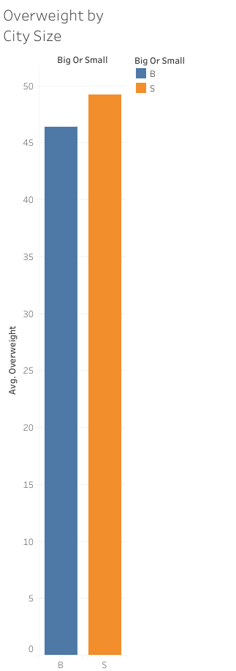

Slide 10
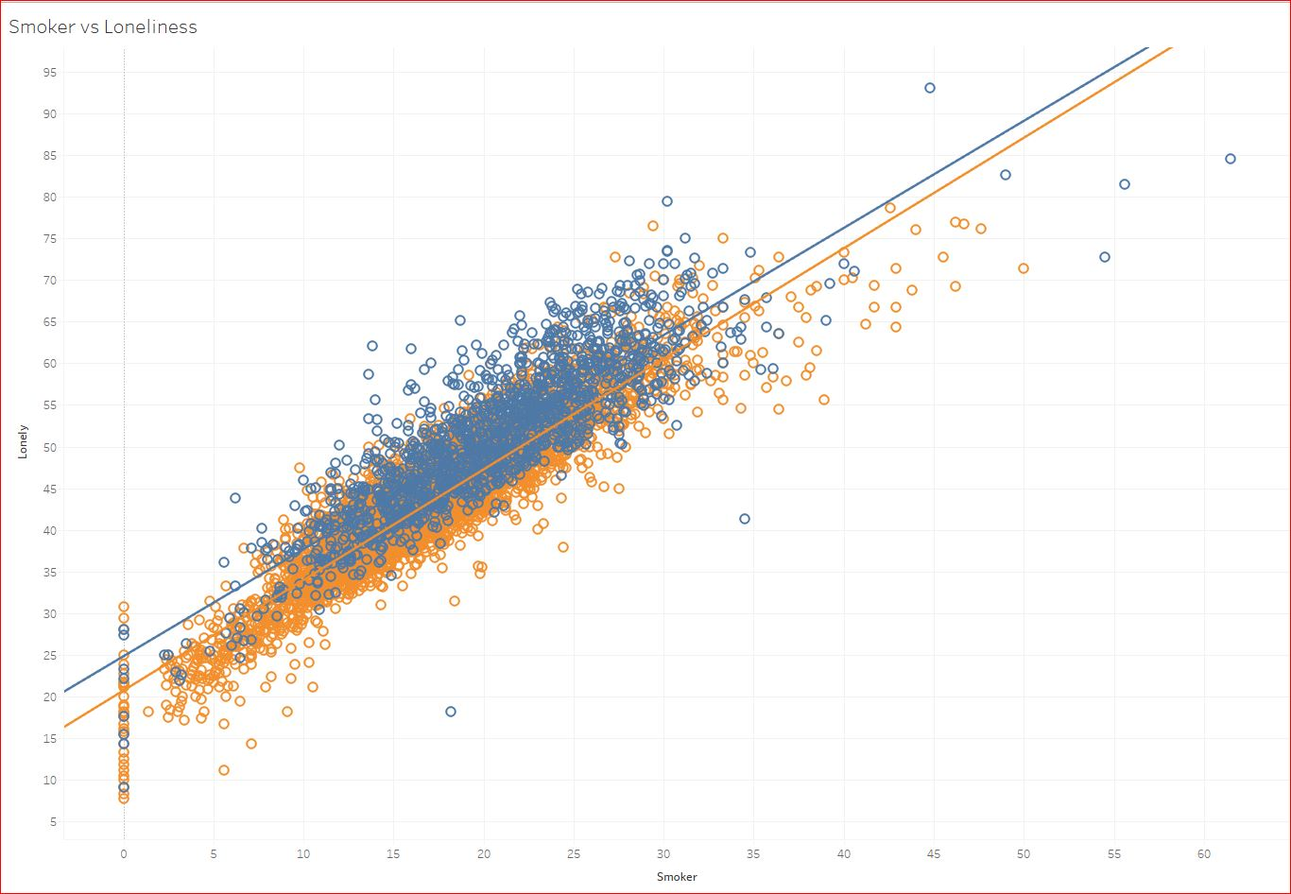
Loneliness vs Smoker by city Size

Slide 11
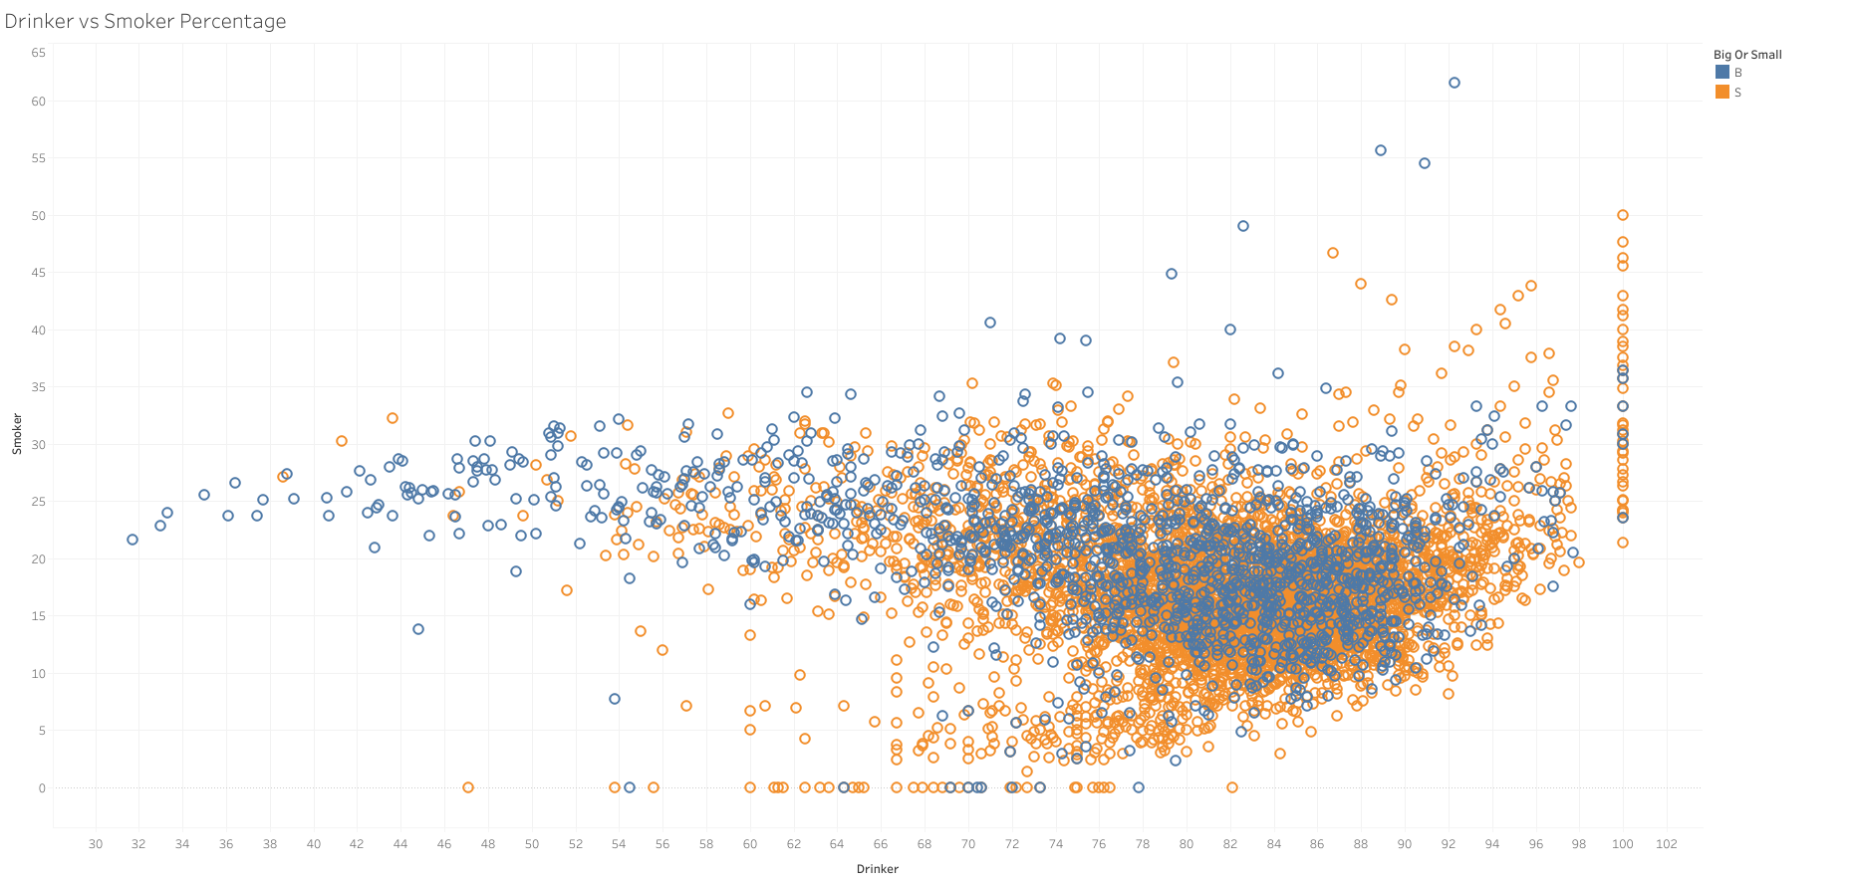
Drinker vs Smoker Percentage

Slide 12
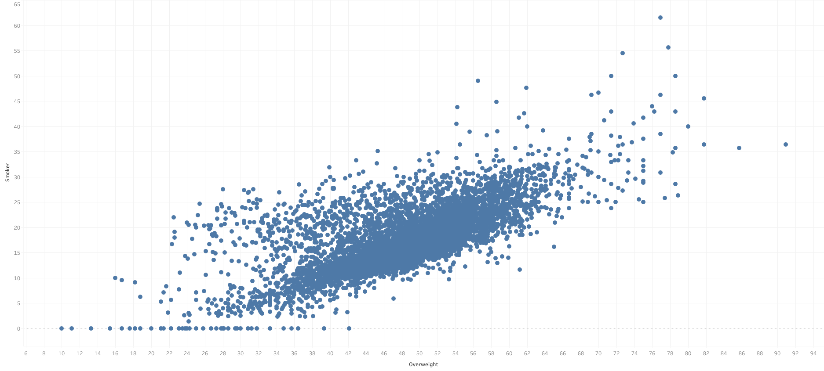
Obesity vs Smoker Percentage

Slide 13
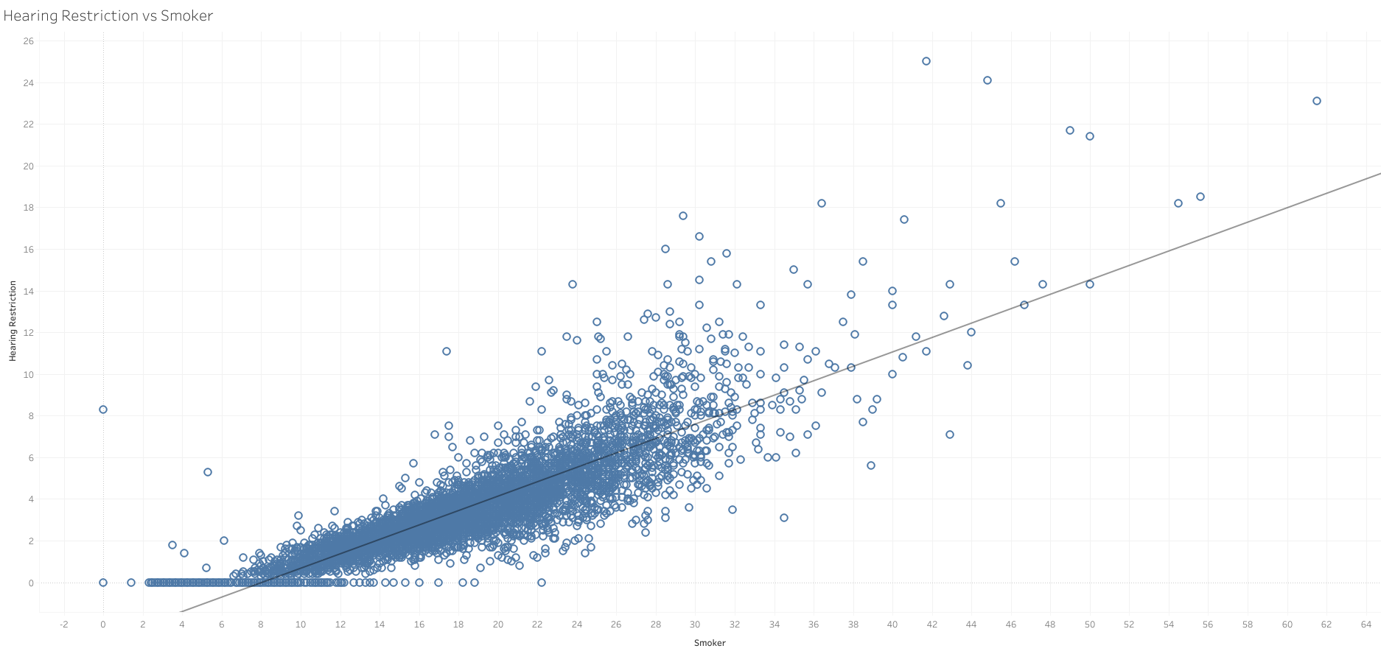
Hearing Restriction vs Smoker Percentage

Slide 14
Two hypotheses
Smoker percentage in big cities is grater than Smoker percentage in small cities
Loneliness percentage in big cities is grater than loneliness percentage in small cities
Notes:
t-value = -16.298340510376637 p-value 1.8798763545186394e-58 we reject null hypothesis
(-3.417985145331314, -2.68923822710945)
t-value = -26.916410277746884 p-value = 1.2420024314620105e-150 we reject null hypothesis
(-7.913898435500508, -6.836812716859802)

Slide 15
Machine Learning Models
A classification model to predict city size based on different features
A linear regression model to predict smoker percentage in each region

Slide 16
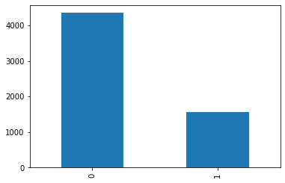
The Classification Model
Synthetic Minority Oversampling (SMOTE) Technique
Classification score= 0.82
[856, 36]
[175, 116]
Classification score= 0.77
[712, 180]
[ 96, 195]

Slide 17
The Linear Regression Model
R2 score= 0.93

Slide 18
Limitations and Suggestions
Limitations
Only south-holland province
People between 18 and 65 years old
This is cross sectional study
Suggestions
Hidden factors such as loneliness, obesity physical disabilities etc.
Loneliness should be one of the policy target in big cities

